Slide 1






COMMERCE MENTORSHIP PROGRAM
MIDTERM REVIEW SESSION
COMM 295
Prepared by: Winson Yu

Slide 2





ABOUT ME

Slide 3
TABLE OF CONTENTS
Introduction
Supply and Demand
Elasticity
Production and Cost
Estimation and Regression Analyses
Perfectly Competitive Markets
Monopoly and Pricing With Market Power
Oligopoly
Game Theory

Slide 4
INTRODUCTION

Slide 5
Economic Theory
An economic theory refers to the development and use of a model to test hypotheses and form explanations for some phenomenon
Useful theories are testable; i.e., if the price of a good increases, the quantity demanded of that product falls
Not useful → human behavior depends on tastes, and tastes change randomly at random intervals

Slide 6
Positive and Normative Statements
A positive (or descriptive) statement is a testable assertion of fact
Does not need to be true, only testable
e.g. advertising on the internet will increase the amount of monthly sales at a car dealership
A normative statement (prescriptive) is one about whether something is good or bad
Often a value judgment
e.g. students should not skip class
Why is it important?
When talking about economic theory and performing economic analyses, it often leads to predictions. It is important to understand this because good economists and managers emphasize positive analyses

Slide 7
Question 1
Increasing the corporate tax rate will decrease corporate profits
This statement is _______________; this is a _______________ statement
Non-testable, positive
Testable, positive
Non-testable normative
Testable normative

Slide 8
Question 1
Increasing the corporate tax rate will decrease corporate profits
This statement is _______________; this is a _______________ statement
Non-testable, positive
Testable, positive
Non-testable, normative
Testable, normative
“Testable assertion of fact”

Slide 9
SUPPLY AND DEMAND

Slide 10
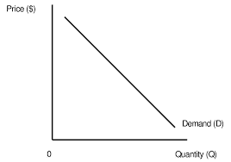
Law of Demand
Quantity demanded rises when price falls
Demand curve slopes downward
→ empirical statement (lots of evidence supporting this law from observation of real markets)

Slide 11
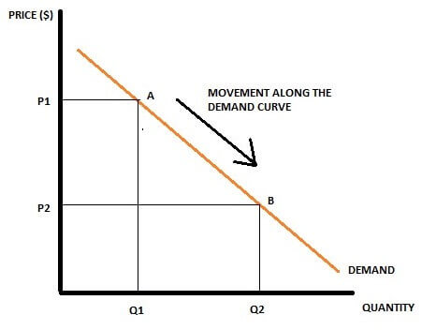
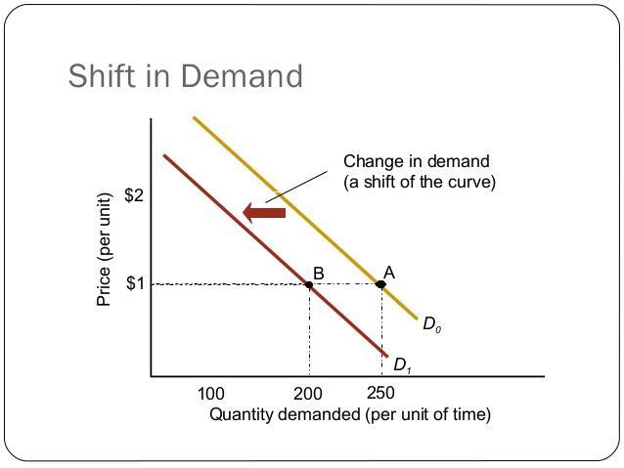
Two Types of Changes
1. Movement along the demand curve
Changes in Price
2. Shift in the demand curve
Entire demand curve shifts leftwards or rightwards as a result of change in demand determinants

Slide 12
Demand Determinants
Shifts in Demand Curve
Changes in income (Y)
Changes in the prices of related goods (substitutes, complements)
Changes in information
Change in consumer tastes

Slide 13
1. Changes in Income
Examples
You get a raise and now have a higher annual salary
Bureau of Labor Statistics reveals that inflation is continuing to remain at elevated levels (i.e. 8.2% YoY inflation)

Slide 14

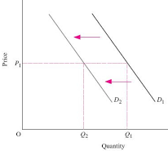
2. Changes in the Prices of Related Goods
Think of substitutes and complements
Example: if the price of green apples decreases, the demand curve for red apples shifts left → substitutes
Market for Red Apples

Slide 15

2. Changes in the Prices of Related Goods
Example: if the price of coffee increases
Complement: cream
Market for Cream

Slide 16
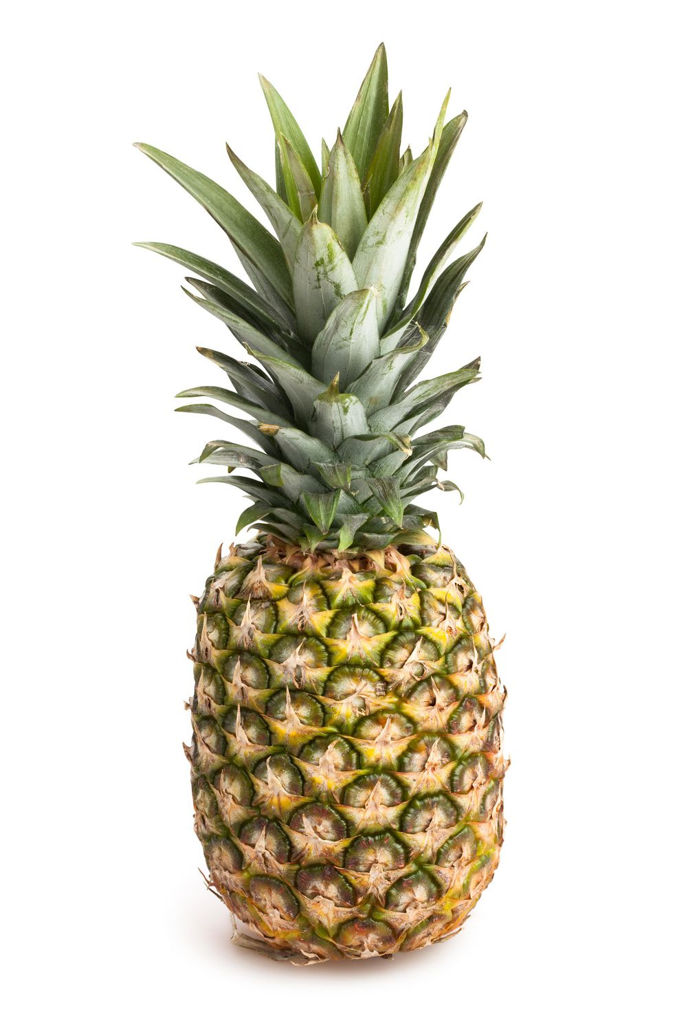
3. Changes in Information
Consumers are very responsive to new information
Example: if new credible research concludes that pineapples are beneficial for your health

Slide 17


4. Changes in Consumer Tastes
Example: if consumers now think Vessis are the new trend, Nikes are out of fashion

Slide 18
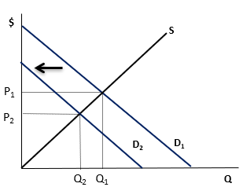
Question 2
Consider the market for coffee as shown below. Coffee is a normal good (demand increases when income increases). Which of the following events might have caused the demand curve to shift to the left (D1 to D2)?
An increase in consumer incomes
A decrease in consumer incomes
A decrease in the price of tea
An increase in the price of coffee
B and C

Slide 19
Question 2
Consider the market for coffee as shown below. Coffee is a normal good (demand increases when income increases). Which of the following events might have caused the demand curve to shift to the left (D1 to D2)?
An increase in consumer incomes
A decrease in consumer incomes
A decrease in the price of tea
An increase in the price of coffee
B and C

Slide 20
Question 3
Suppose that the market demand for vests is characterized by the market demand equation Q = 5000−5P+5P_{R}, where Q and P denote quantity demanded and price of vests and P_{R} is the price of a related good R, and market supply for vests is Q = 300+5P
(a) What is the relationship between vests and R?
(b) Suppose P_{R} = 150 initially. Calculate the equilibrium price and quantity for vests. Show this outcome in a clearly-labeled diagram.
(c) Suppose the price of R increases to P_{R} = 200. Show this change in the diagram you drew for part (b) and calculate the resulting equilibrium price and quantity for vests.

Slide 21
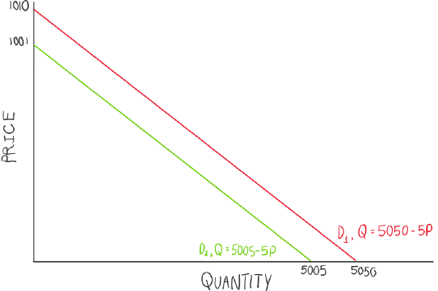
Question 3
Suppose that the market demand for vests is characterized by the market demand equation Q = 5000−5P+5P_{R}, where Q and P denote quantity demanded and price of vests and P_{R} is the price of a related good R, and market supply for vests is Q = 300+5P
(a) What is the relationship between vests and R?
Q=5000−5P+5P_{R}
Market supply for vests is Q=300+5P
P_{R} is the price of a related good R
Compare:
Q=5000-5P+5(1) = 5005-5P
Q=5000-5P+5(10) = 5050-5P
Price of related good increases from $1 to $10
The market demand curve for vests shifts right when the price of related good increases
They are substitutes

Slide 22
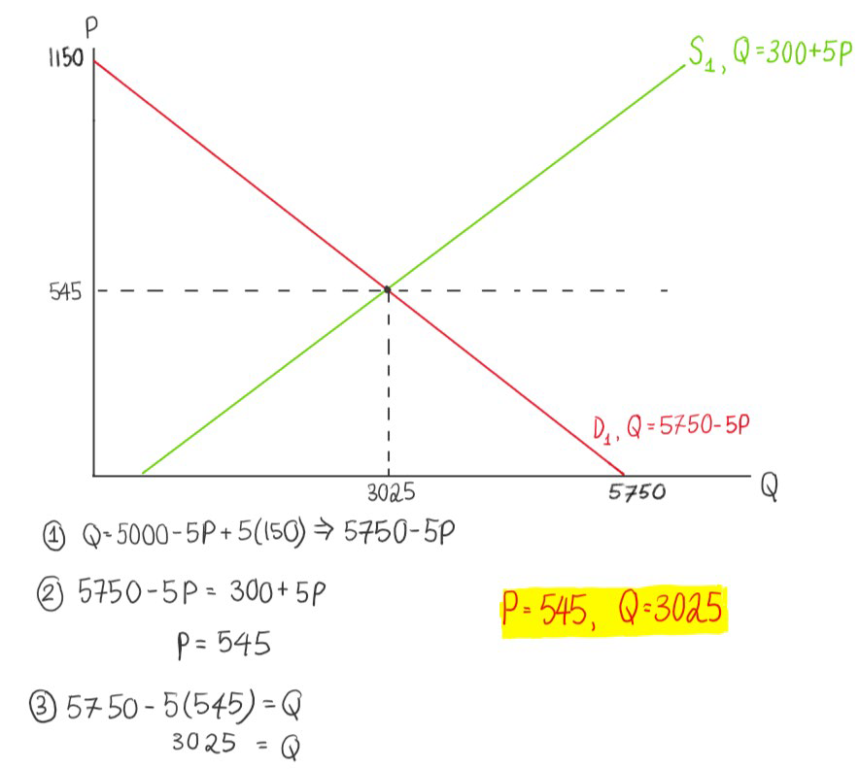
Question 3
Suppose that the market demand for vests is characterized by the market demand equation Q = 5000−5P+5P_{R}, where Q and P denote quantity demanded and price of vests and P_{R} is the price of a related good R, and market supply for vests is Q = 300+5P
(b) Suppose P_{R} = 150 initially. Calculate the equilibrium price and quantity for vests. Show this outcome in a clearly-labeled diagram.
Q=5000−5P+5P_{R}
Market supply for vests is Q=300+5P
PR is the price of a related good R
Equilibrium price: 545
Quantity: 3025

Slide 23
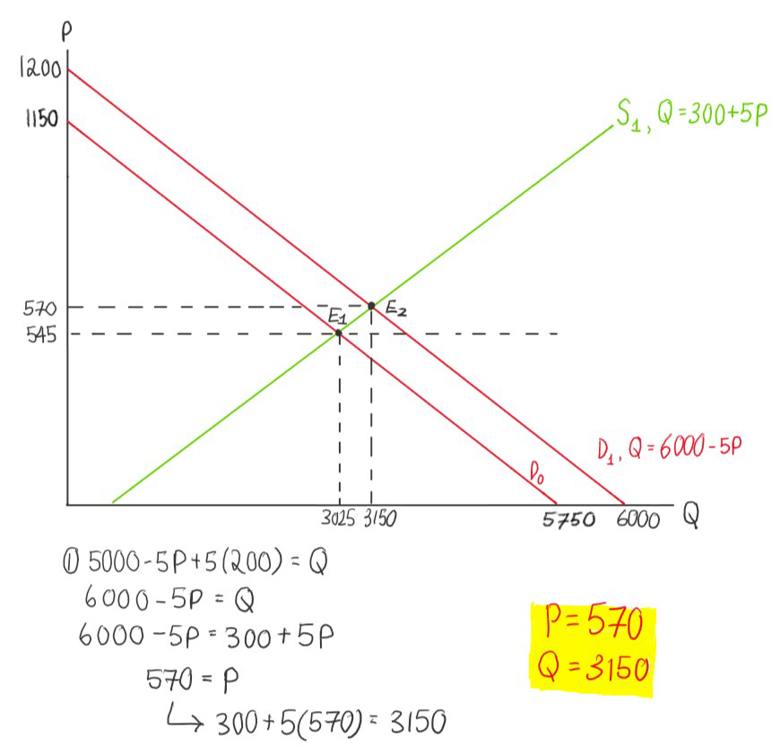
Question 3
Suppose that the market demand for vests is characterized by the market demand equation Q = 5000−5P+5P_{R}, where Q and P denote quantity demanded and price of vests and P_{R} is the price of a related good R, and market supply for vests is Q = 300+5P
(c) Suppose the price of R increases to PR = 200. Show this change in the diagram you drew for part (b), and calculate the resulting equilibrium price and quantity for vests.
Q=5000−5P+5P_{R}
Market supply for vests is Q=300+5P
PR is the price of a related good R
Equilibrium price: 570
Quantity: 3150

Slide 24
ELASTICITY

Slide 25
Price Elasticity of Demand
Textbook definition: measures the percentage change in the quantity demanded resulting from a percentage change in price.
In most cases, it is a negative number (negative relationship)
As price increases, quantity demanded decreases
As price decreases, quantity demanded increases
Another way of thinking: it is the responsiveness of quantity demanded to a change in price

Slide 26
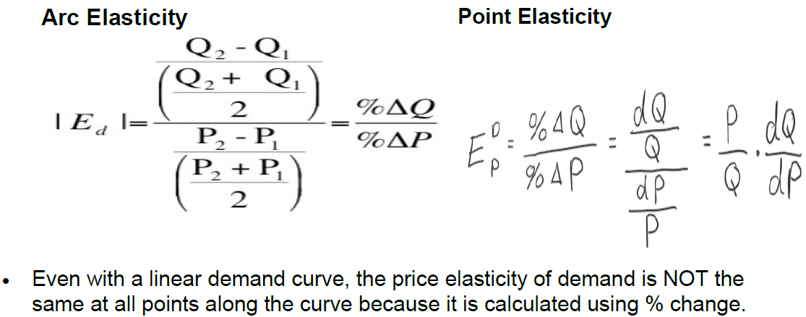
Equations

Slide 27
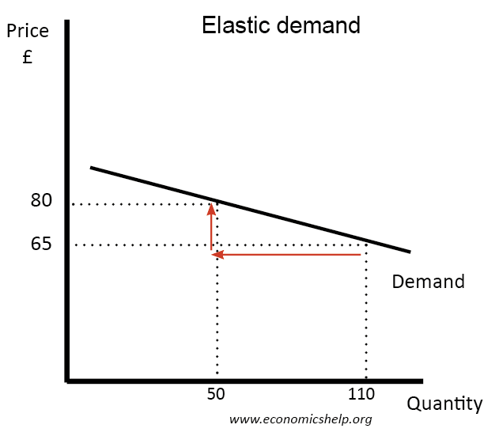
Elastic Demand
Demand for which a percentage change in a product’s price causes a larger percentage change in quantity demanded
Shown with a flatter curve
When |ε| > 1, it is price elastic
When demand is elastic, total revenue and the change in price have an inverse relationship → total revenue changes in the opposite direction to the change in price.

Slide 28
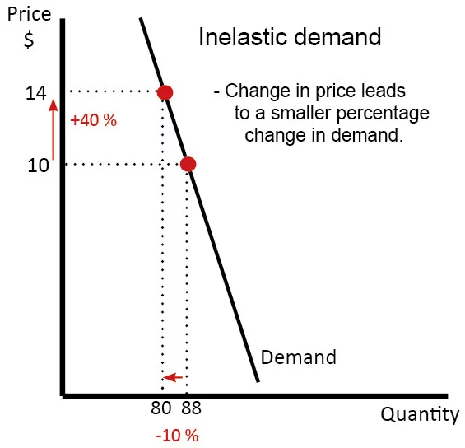
Inelastic Demand
Demand for which a percentage change in a product’s price causes a smaller percentage change in quantity demanded.
Shown with a steeper curve
When 0 < |ε| < 1, it is price inelastic
When the demand is inelastic, the price and total revenue have a direct relationship → total revenue changes in the same direction as the change in price.

Slide 29
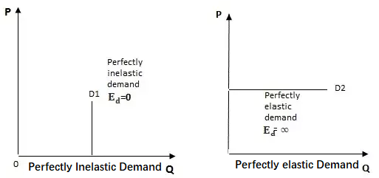
Perfectly Elastic and Perfectly Inelastic Demand
Perfectly inelastic demand is an economic condition in which a change in the price of a product or a service has no impact on the quantity demanded (i.e. insulin)
Perfectly elastic demand is a demand where any price increase would cause the quantity demanded to fall to zero and reducing the price of a good or service will not increase sales.(i.e. PC market with identical burger stands side by side – raising price would reduce units sold to 0)

Slide 30
Question 4
Here is a table showing the percentage changes in price and quantity
What are the elasticities?
When does the law of demand hold?
Change in Quantity | Change in Price | Elasticity
-8% | 8% | ?
-7% | 4% | ?
30% | 6% | ?

Slide 31
Question 4
Here is a table showing the percentage changes in price and quantity
What are the elasticities?
When does the law of demand hold?
Law of Demand: quantity demanded rises when price falls
6% increase in price causes a 30% increase in quantity → law of demand does not hold as this is not an inverse relationship
Change in Quantity | Change in Price | Elasticity
-8% | 8% | -1
-7% | 4% | -7/4
30% | 6% | 5

Slide 32
Question 5
Assume that an inverse demand function is P = 200 – 15Q where P is dollars per pound and Q is thousands of pounds
Increasing quantity from Q = 1 to Q = 2 decreases price by 0.15 percent.
Total sales revenue, R = PQ, is positive for all positive values of Q.
Demand is inelastic when Q = 5
Demand is elastic when Q = 5

Slide 33
Question 5
Assume that an inverse demand function is P = 200 – 15Q where P is dollars per pound and Q is thousands of pounds
Increasing quantity from Q = 1 to Q = 2 decreases price by 15 percent.
Total sales revenue, R = PQ, is positive for all positive values of Q.
Demand is inelastic when Q = 5
Demand is elastic when Q = 5
When Q = 1, P = 200 – 15(1) = 185 When Q = 2 P = 200 – 15(2) = 170 Price decreases by 8.1%
Revenue = 200Q – 15Q² False, revenue is negative when Q > 40/3
P/Q * dQ/dP = 125/5 * (-1/15) = -1.67 (Elastic)

Slide 34
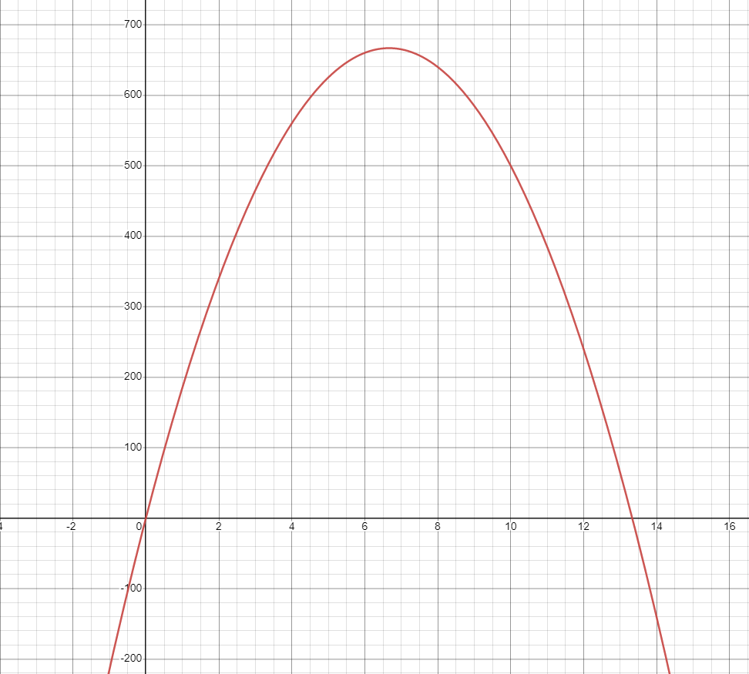
Question 5
Assume that an inverse demand function is P = 200 – 15Q where P is dollars per pound and Q is thousands of pounds
Increasing quantity from Q = 1 to Q = 2 decreases price by 15 percent.
Total sales revenue, R = PQ, is positive for all positive values of Q.
Demand is inelastic when Q = 5
Demand is elastic when Q = 5

Slide 35
PRODUCTION & COST

Slide 36
Measures of Productivity
Average Product of Labor: APL = Q/L
Average Product of Capital: APK = Q/K
Marginal Product of Labor: MPL = dQ/dL (assuming K is constant)
Marginal Product of Capital: MPK = dQ/dK (assuming L is constant)

Slide 37
Returns to Scale
Constant returns to scale: output increases in proportion to the increase in input
Increasing returns to scale: output increases more than the increase in input
Decreasing returns to scale: output increases less than the increase in input

Slide 38
Economies of Scale
Economies of scale mean that the average cost falls as output rises.
Constant costs means average cost is constant as output rises.
Diseconomies of scale means average cost rises as output rises.
Economies of scale are normally caused by increasing returns to scale.
Economies of scale is a cost concept; increasing returns to scale is a production concept.
They are related but are not the same thing.

Slide 39
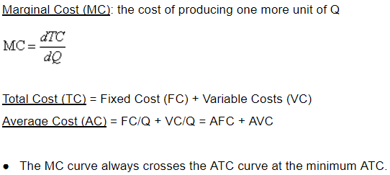
Costs

Slide 40
Law of Diminishing Marginal Returns (Thomas Malthus)
If a firm keeps increasing an input, holding all other inputs and technology constant, the corresponding increases in output will eventually become smaller
e.g. growing wheat requires suitable land, seeds, labor, capital in the form of machines, fertilizer, and possibly other chemical inputs. Increasing the amount of land, while holding all other inputs fixed, will eventually reach a point where additional land produces little additional output

Slide 41
Question 6
Here are two production functions. K is fixed (and positive).
q = 10K + 5L
q = 10KL^{0.5}
Both production functions satisfy the LDMR.
Only production function 1 satisfies the LDMR.
Only production function 2 satisfies the LDMR.
Neither production function satisfies the LDMR.
Not enough information is given to answer the question.

Slide 42
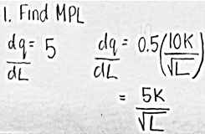
Question 6
Here are two production functions. K is fixed (and positive).
q = 10K + 5L
q = 10KL^{0.5}
Both production functions satisfy the LDMR.
Only production function 1 satisfies the LDMR.
Only production function 2 satisfies the LDMR.
Neither production function satisfies the LDMR.
Not enough information is given to answer the question.
LDMR: If a firm keeps increasing an input, holding all other inputs and technology constant, the corresponding increases in output will eventually become smaller
q = 10K + 5L → constant returns to scale
q = 10KL^0.5 → decreasing returns to scale

Slide 43

Question 7
The average variable cost of producing Canucks jerseys is given by AVC = 3 + 0.03q. The total cost of producing 100 Canucks jerseys is 1375.
Find the:
Marginal cost
Fixed cost
Total cost of producing 80 Canucks jerseys

Slide 44
Question 7
The average variable cost of producing Canucks jerseys is given by AVC = 3 + 0.03q. The total cost of producing 100 Canucks jerseys is 1375.
Find the:
Marginal cost
Fixed cost
Total cost of producing 80 Canucks jerseys
Step 1:
AVC= VC / Q → VC = (AVC)(Q)
(3+0.03Q)(Q) = VC → 3Q+0.03Q²
Step 2:
TC= FC + VC
1375 = FC + 3(100) + 0.03(100)²
775= FC
TC=775+3Q+0.03Q²
MC=3+0.06Q
Marginal Cost:
MC = 3+0.06Q
MC = 3+0.06(100) = 9
Total cost of producing 80 Canucks jerseys
TC = 775+3(80)+0.03(80)² = 1207

Slide 45
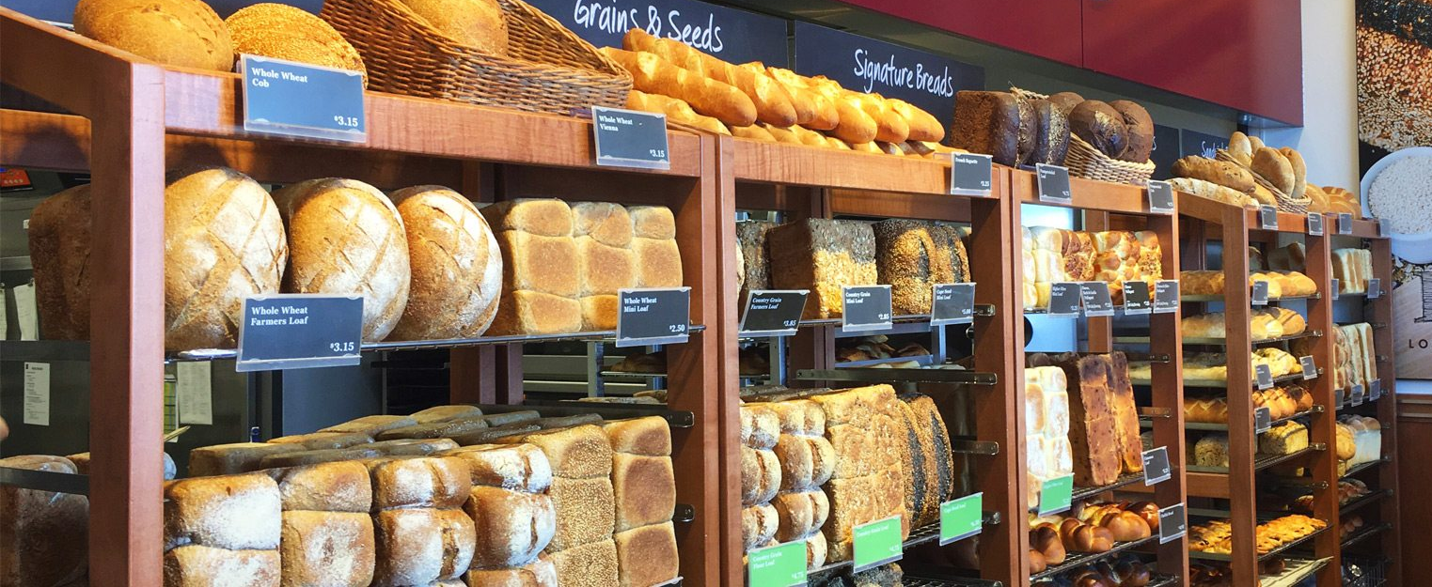
Question 8
If the production function of Pitt Meadows Bakery is Q = K^{0.5}L^{0.8}, assuming K is constant, what kind of returns of scale does Pitt Meadows Bakery have?

Slide 46
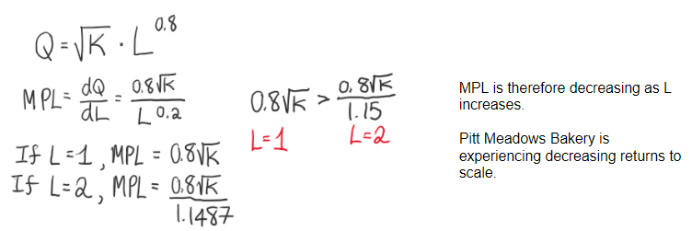
Question 8
If the production function of Pitt Meadows Bakery is Q = K^{0.5}L^{0.8}, assuming K is constant, what kind of returns of scale does Pitt Meadows Bakery have?

Slide 47
Estimation and Regression Analysis

Slide 48
Regression Analysis
statistical technique used to estimate the mathematical relationship between a dependent variable and one or more explanatory variables
When estimating a demand curve, the points do not lie on the line precisely due to random error
The residual is the vertical distance between the estimated demand curve and the actual data points

Slide 49
Regression Analysis
When we use Excel, the method of “ordinary least squares” is used
this method makes the sum of squared residuals as small as possible to form an estimated regression line
The degree to which a regression line is a “good fit” for the data can be measured by the R² value.
R² value: measures how well the estimated regression line fits the data; the proportion of total variance (of the response variable) that is explained by the model (the explanatory variable)
When R² is 1.0, 100% of the variation in the response variable is explained by the explanatory variable

Slide 50
Regression Analysis
Standard error: how much the estimated coefficient would vary in repeated samples
Small standard errors indicate precise estimates
Various estimated coefficients are tightly bunched around the true coefficient
T-statistic: equals the coefficient divided by the standard error
Larger t-statistics indicate greater confidence that the true coefficient differs from zero
When the absolute value of the t-statistic is greater than 2, it is considered important or “statistically significant”

Slide 51
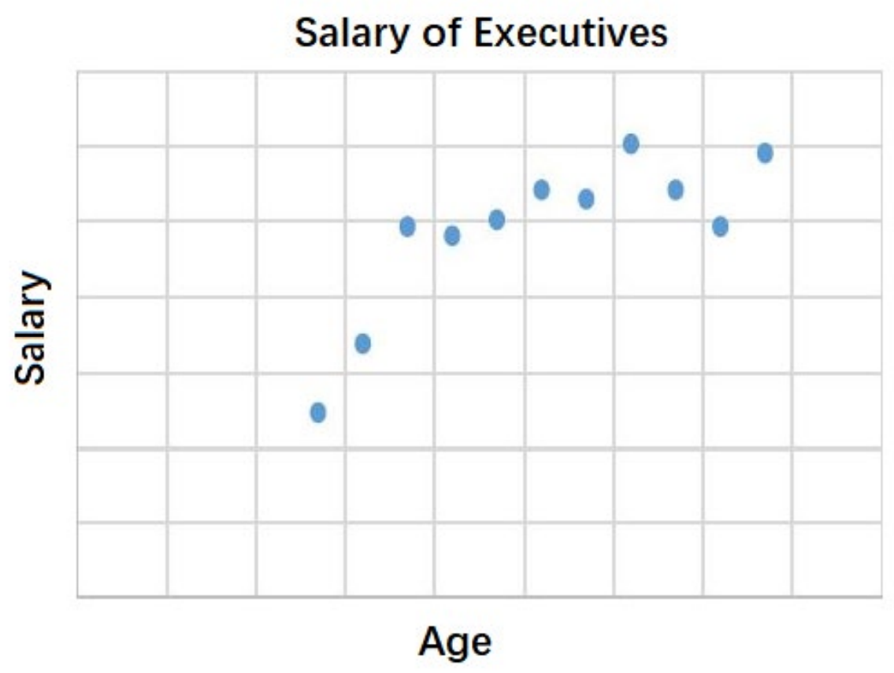
Question 10
Consider the following scatterplot outlining the salaries of executives.
Which answer is true?
The linear OLS regression under-estimates the salary of younger executives
The linear OLS estimation is likely to show that marginal returns to age is diminishing
The R² value with linear OLS regression is likely to be higher than that with quadratic estimation.
The quadratic OLS estimation shows that executive’s salary increases with age at an increasing rate

Slide 52
Question 10
Consider the following scatterplot outlining the salaries of executives.
Which answer is true?
The linear OLS regression under-estimates the salary of younger executives
The linear OLS estimation is likely to show that marginal returns to age is diminishing
The R² value with linear OLS regression is likely to be higher than that with quadratic estimation.
The quadratic OLS estimation shows that executive’s salary increases with age at an increasing rate

Slide 53
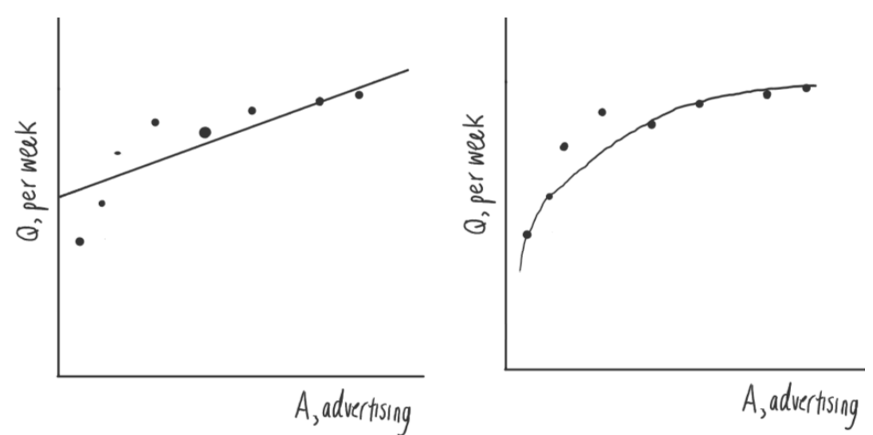
Question 11
Use the two regressions that illustrate the effect of advertising expenditure on quantity demanded below to choose the correct statement(s).
Find the:
The quadratic regression fits the data better and has a smaller R² statistic value
The coefficient for A² in the quadratic regression should be statistically significant
The quadratic regression curve underestimates the effect of A because the level of advertisement when A=4 generates a demand Q above what is predicted by the regression curve
All of the above

Slide 54
Question 11
Use the two regressions that illustrate the effect of advertising expenditure on quantity demanded below to choose the correct statement(s).
Find the:
The quadratic regression fits the data better and has a smaller R² statistic value
The coefficient for A² in the quadratic regression should be statistically significant
The quadratic regression curve underestimates the effect of A because the level of advertisement when A=4 generates a demand Q above what is predicted by the regression curve
All of the above
R² value should be relatively high
“Statistically significant” when the |t-stat| > 2
Estimated coefficient / standard error = t-statistic value
We know this because the standard error is quite small for each point
T-stat should be greater than 2
A single point that is above the regression curve would not mean that the
entire quadratic regression curve underestimates the effect of A

Slide 55
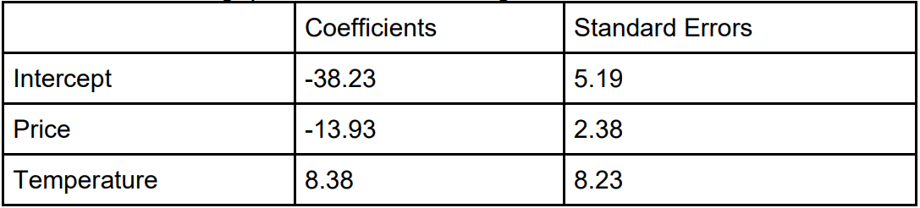
Question 12
Karen is selling strawberries outside of The Nest. She is curious about how the quantity of strawberries sold (Qs) is affected by the temperature of the day (T) and the price he sets. After collecting information about Q, P, and T in a single day, she runs a regression of Q on P and T. The results from the regression are shown in the table below, with R-squared statistic being 0.91. Answer the following questions about this regression.
1. The dependent variable is _____________________.
2. The estimated demand function is _______________________________.
3. The t-stat for the coefficient of temperature (T) is _________________ and the t-stat for the coefficient of price (P) is ______________________.
4. State whether the coefficients on temperature (T) and price (P) are statistically significant at the 5% significance level and explain how you know that.
5. After trying another regression specification by not including temperature (T) in
the regression, the R-squared statistic changes to 0.73. Is this new specification
better or worse than the original one?

Slide 56
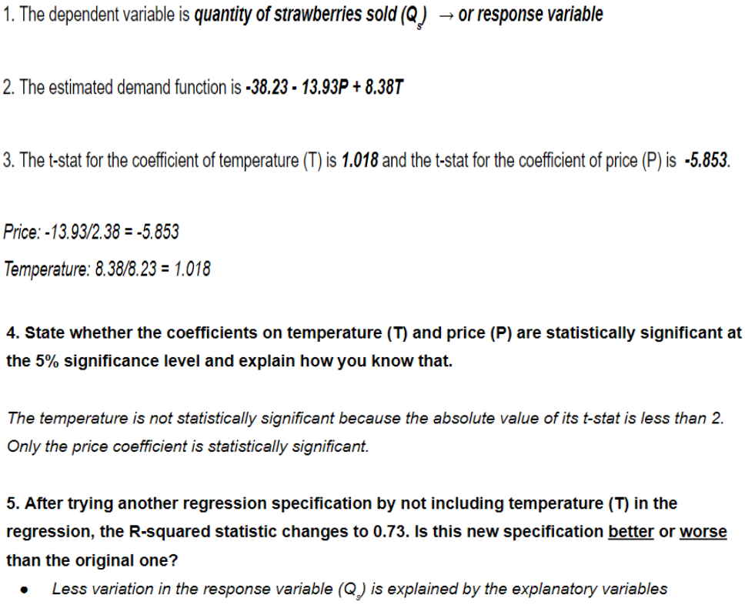
Question 12
Karen is selling strawberries outside of The Nest. She is curious about how the quantity of strawberries sold (Qs) is affected by the temperature of the day (T) and the price he sets. After collecting information about Q, P, and T in a single day, she runs a regression of Q on P and T. The results from the regression are shown in the table below, with R-squared statistic being 0.91. Answer the following questions about this regression.

Slide 57
Perfectly Competitive Markets

Slide 58
Characteristics of Perfectly Competitive Firms
1. Price-Taking: The individual firm produces a very small share of the total market output and, therefore, cannot influence the market price
2. Product Homogeneity: The products of all firms are perfect substitutes
3. Freedom of Entry and Exit: There are no costs that make it difficult for a firm to enter or stay in the industry.
4. Perfect Information: Buyers and sellers have perfect information.
5. Low Transaction Costs: There are low transaction costs of buying and selling.

Slide 59
Characteristics of Perfectly Competitive Firms
Profit for Competitive Firms: π(q) = R(q) – C(q)
Output Decision:
The profit of competitive firms is maximized when P=MR=MC
For competitive firms, the marginal revenue is equal to price
MR=MC is the level of output where marginal profits are zero (or when there is no further room for increasing profits by producing more).

Slide 60
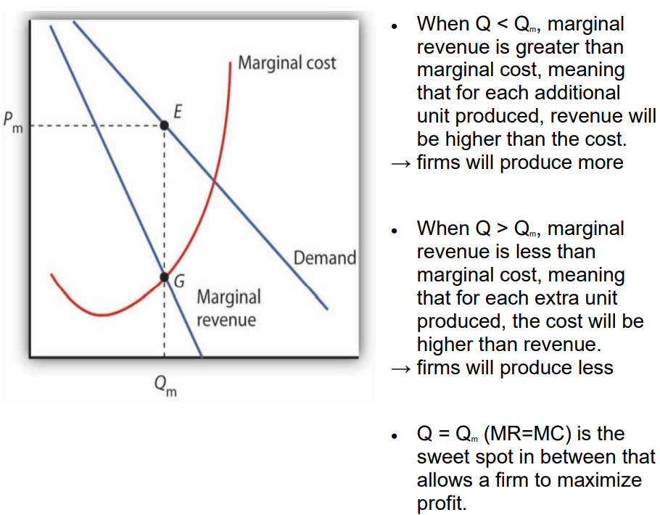
Characteristics of Perfectly Competitive Firms

Slide 61
Short Run Shutdown Decision
If P > AVC, a firm will still produce even if it is experiencing a loss
This is because firms can reduce their losses by producing more when P > AVC
Revenue can cover all of VC and a portion of FC. As a result, by producing, the firm’s loss < FC
In the short run, firms can avoid variable costs (VC) such as labor costs by shutting down, but not the (sunk) fixed costs (such as rent)
If P < AVC, the firm will shut down
In this case, the firm cannot cover even its VC. By producing, the loss becomes greater than FC
If it shuts down, then the firm’s loss is limited to its FC

Slide 62
Long Run Shutdown Decision
In the long run, all costs (FC and VC) are avoidable
If P < ATC, then the firm will shut down
If P > ATC, then the firm will continue to produce
The Short Run Supply Curve
The short run supply curve is the MC above the minimum AVC
Firms won’t supply when MC < AVC for the same reason why firms shutdown when P < AVC;
producing below the minimum of AVC increases firm’s losses.

Slide 63
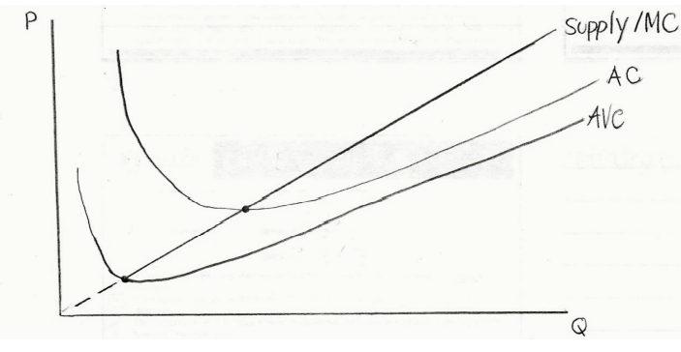
The Short Run Supply Curve
The short run supply curve is the MC above the minimum AVC
Firms won’t supply when MC < AVC for the same reason why firms shutdown when P < AVC
producing below the minimum of AVC increases firm’s losses.

Slide 64
Short Run Market Supply Curve
Horizontal sum of the supply curves of all individual firms
The maximum number of firms in a market is fixed in the SR
Market supply curve at any price is n times the supply of an individual firm
The larger the n, the flatter (more elastic) the SR market supply curve is at each price
More firms → more responsive to changes in price → more elastic

Slide 65
Question 13
Which of the following is true for a perfectly competitive industry with identical profit-maximizing firms in a long-run equilibrium?
Firms produce where P = MC.
Firms produce where P = AC.
Each firm produces at the minimum of its long run average cost curve.
a and b.
All of the above.

Slide 66
Question 13
Which of the following is true for a perfectly competitive industry with identical profit-maximizing firms in a long-run equilibrium?
Firms produce where P = MC.
Firms produce where P = AC.
Each firm produces at the minimum of its long run average cost curve.
a and b.
All of the above.

Slide 67

Question 14
Assume that the golden retriever adoption industry is perfectly competitive. There are n identical firms (n is limited). Each firm has the following total cost function in the short run and the long run: C(q) = 25 + 5q + q² where q represents the number of golden retrievers. The fixed cost is unavoidable in the short run but avoidable in the long run.
What is the marginal cost function for each firm?
What is the equation for the firm’s supply function?
What is the average variable cost function for each firm? At what price should the firm shut down?
What is the average cost function for each firm? At what price will firms exit the industry in the long run?
Suppose that market demand is given by Q = 200 – 2P. The long run industry equilibrium price is 15 and the industry output quantity is 170.
In the long run equilibrium, there will be ______ firms and each firm produces quantity ______.

Slide 68
Question 14
Assume that the golden retriever adoption industry is perfectly competitive. There are n identical firms (n is limited). Each firm has the following total cost function in the short run and the long run: C(q) = 25 + 5q + q² where q represents the number of golden retrievers. The fixed cost is unavoidable in the short run but avoidable in the long run.
1. What is the marginal cost function for each firm?
MC = 2Q+5
2. What is the equation for the firm’s supply function?
Q = 0.5P-2.5 → Q as a function of P

Slide 69
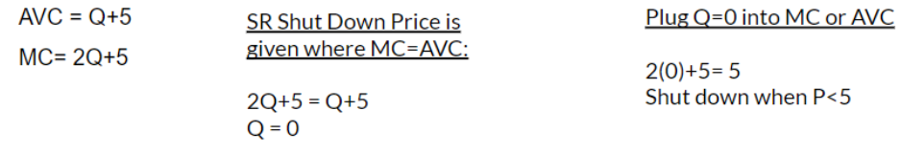
Question 14
Assume that the golden retriever adoption industry is perfectly competitive. There are n identical firms (n is limited). Each firm has the following total cost function in the short run and the long run: C(q) = 25 + 5q + q² where q represents the number of golden retrievers. The fixed cost is unavoidable in the short run but avoidable in the long run.
3. What is the average variable cost function for each firm? At what price should the firm shut down?

Slide 70
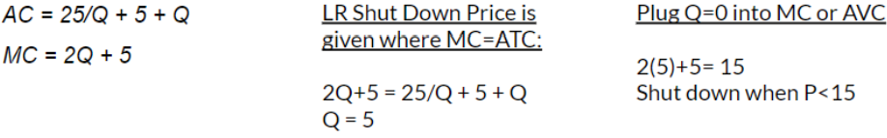
Question 14
Assume that the golden retriever adoption industry is perfectly competitive. There are n identical firms (n is limited). Each firm has the following total cost function in the short run and the long run: C(q) = 25 + 5q + q² where q represents the number of golden retrievers. The fixed cost is unavoidable in the short run but avoidable in the long run.
4. What is the average cost function for each firm? At what price will firms exit the industry in the long run?

Slide 71
Question 14
Assume that the golden retriever adoption industry is perfectly competitive. There are n identical firms (n is limited). Each firm has the following total cost function in the short run and the long run: C(q) = 25 + 5q + q² where q represents the number of golden retrievers. The fixed cost is unavoidable in the short run but avoidable in the long run.
5. Suppose that market demand is given by Q = 200 – 2P. The long run industry equilibrium price is 15 and the industry output quantity is 170.
Long run equilibrium price was solved in the Question 4
Quantity: 200 - 2(15) = 170
The long run equilibrium price of the industry is the shutdown price of a firm because firms make normal profits in the long run.

Slide 72
Question 14
Assume that the golden retriever adoption industry is perfectly competitive. There are n identical firms (n is limited). Each firm has the following total cost function in the short run and the long run: C(q) = 25 + 5q + q² where q represents the number of golden retrievers. The fixed cost is unavoidable in the short run but avoidable in the long run.
6. In the long run equilibrium, there will be ______ firms and each firm produces quantity ______.
The long run quantity produced in the industry is 170
Each firm produces 5 units in the long run.
# of firms = market output / individual output
170/5 = 34 firms

Slide 73
Monopoly and Pricing with Market Power

Slide 74
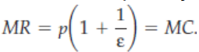
Monopoly
a sole supplier of a good for which there is no close substitute.
as a single supplier, a monopolist faces the entire (downward sloping) market demand.
a monopoly’s output is the market output
Profit Maximization: MR=MC
Profit-maximizing managers set their quantity according to this formula:

Slide 75
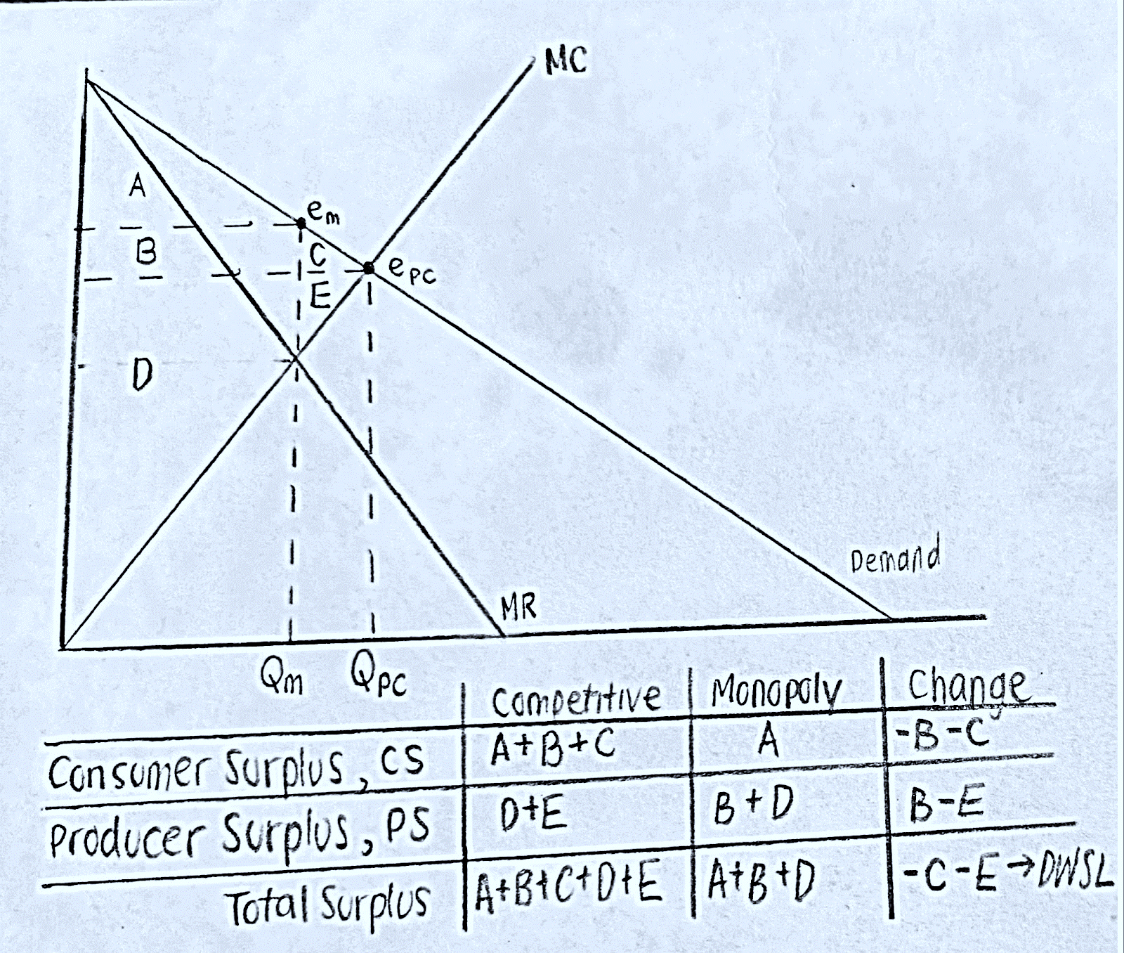
Comparison of Consumer and Producer Surplus

Slide 76
Pricing with Market Power
Perfect price discrimination: Monopolist charges the maximum price that each
consumer is willing to pay.
Multi-group price discrimination: Splitting consumers into two or more groups based
on their demand curve and charging different prices to each group.
Non-linear Price Discrimination: Charging different prices based on the quantity
Two-Part Pricing: Charging an entry fee and a usage fee
Bundling: selling products together in sets
Pure Bundling: works when there is a negative correlation between the demands of consumers
Changes lower price but increases the number of consumers.
Mixed Bundling: allow the customer to buy the pure bundle or any of the bundle’s components separately
Peak Load Pricing: charging higher prices during periods of peak demand in other periods
used when there is a capacity constraint
increases profits and spreads demand during off-peak time

Slide 77
Question 15
A monopoly faces a market demand curve given by P = 15-0.25Q. Its cost function is C=15+5Q
Calculate the profit maximizing output and price for the monopolist (under uniform pricing strategy).
On a diagram, draw the demand curve, marginal revenue curve, and marginal cost curve. Clearly label the axes.
The deadweight loss under this uniform pricing strategy is _________. If the monopoly can carry out first-degree price discrimination, the deadweight loss in that case would be ______.

Slide 78
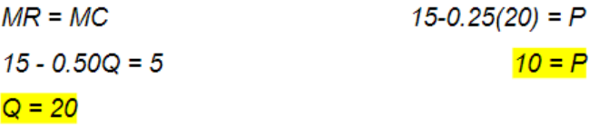
Question 15
A monopoly faces a market demand curve given by P = 15-0.25Q. Its cost function is C=15+5Q
A. Calculate the profit maximizing output and price for the monopolist (under uniform pricing strategy).

Slide 79
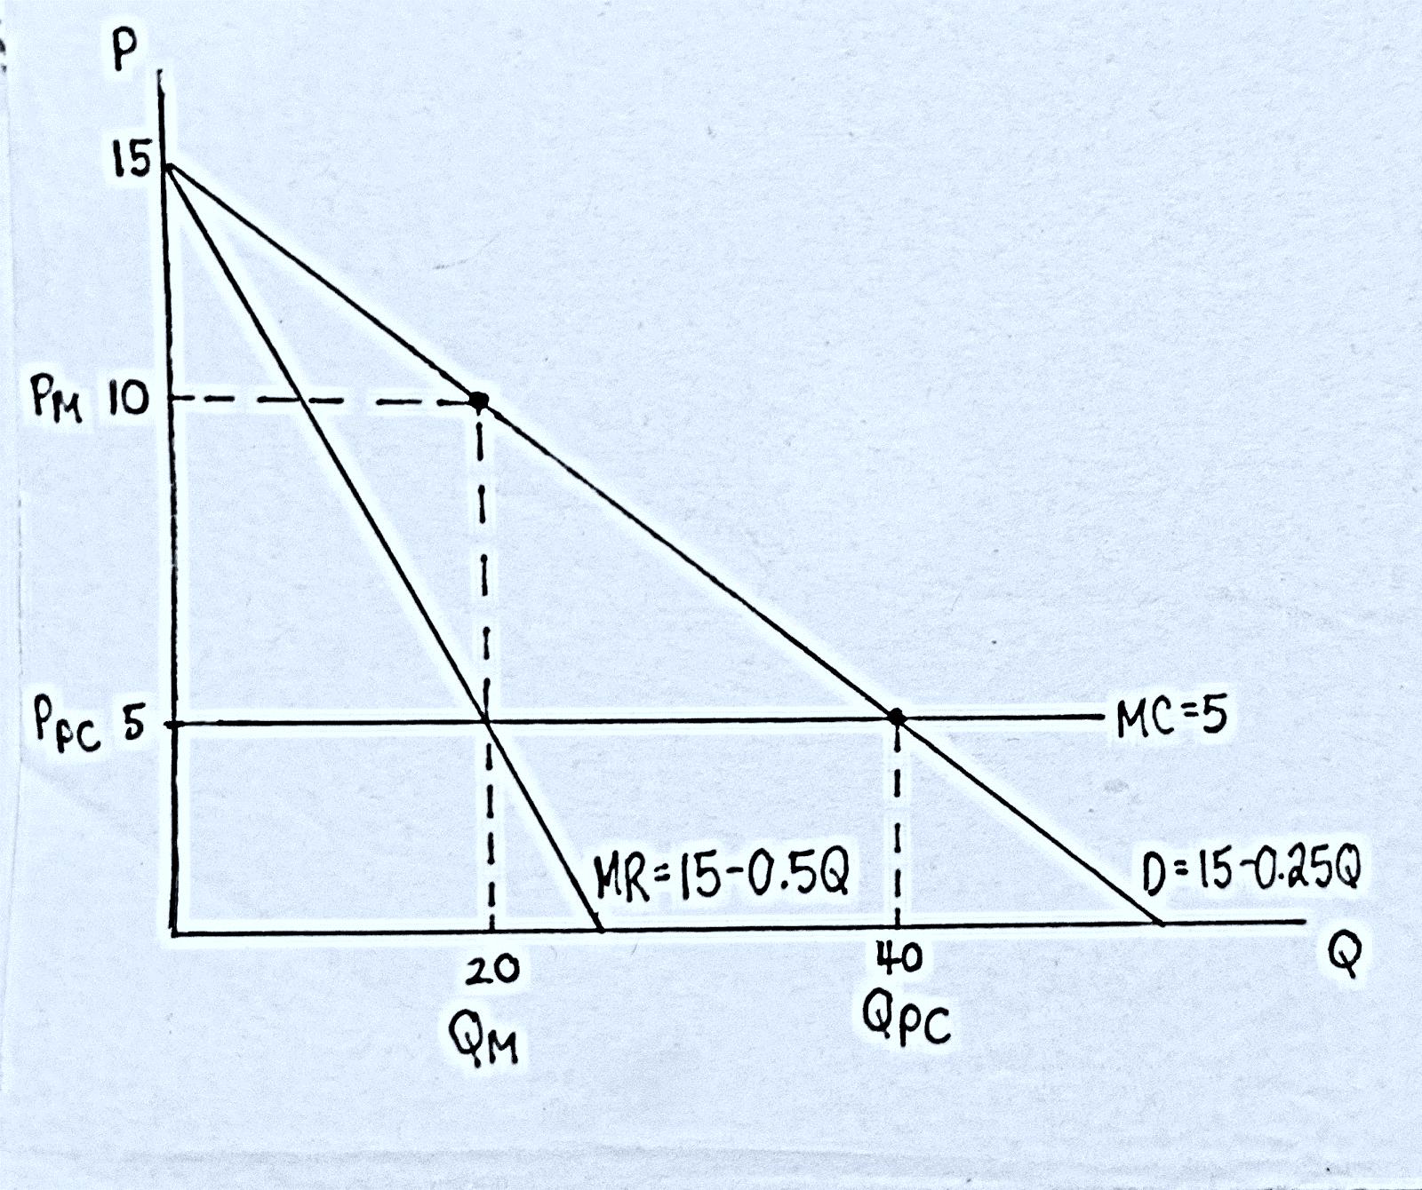
Question 15
A monopoly faces a market demand curve given by P = 15-0.25Q. Its cost function is C=15+5Q
B. On a diagram, draw the demand curve, marginal revenue curve, and marginal cost curve. Clearly label the axes.

Slide 80
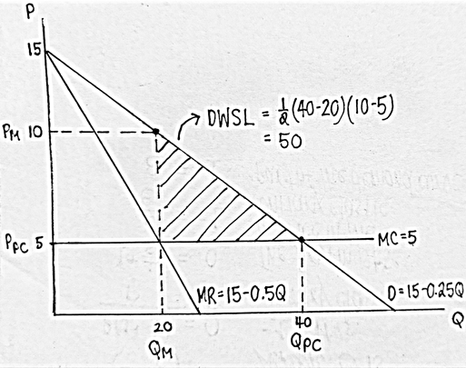
Question 15
A monopoly faces a market demand curve given by P = 15-0.25Q. Its cost function is C=15+5Q
C. The deadweight loss under this uniform pricing strategy is 50. If the monopoly can carry out first-degree price discrimination, the deadweight loss in that case would be 0.
With perfect price discrimination, all surplus is captured because the firm charges each customer’s reservation price.

Slide 81
Question 16
The table provides the reservation prices for three students who are deciding what to do during in the summer. The students could travel to San Diego or New York. For this question, we will assume that these are the only students, and the marginal cost is 0 for both choices. A travel agency is considering whether to use stand-alone pricing or pure bundling pricing strategy.
 | New York | San Diego | Bundle
Steven | 110 | 100 | ?
Brian | 105 | 125 | ?
Carl | 100 | 150 | ?
A. Fill in the willingness to pay for the bundles in the above table
B. With stand-alone pricing, France should be priced at ________ and Germany should be priced at ________. The profit from both products is ________.
C. With pure bundling, the profit-maximizing price for the bundle is ________, and the profit is ________.

Slide 82
Question 16
The table provides the reservation prices for three students who are deciding what to do during in the summer. The students could travel to San Diego or New York. For this question, we will assume that these are the only students, and the marginal cost is 0 for both choices. A travel agency is considering whether to use stand-alone pricing or pure bundling pricing strategy.
 | New York | San Diego | Bundle
Steven | 110 | 100 | 210
Brian | 105 | 125 | 230
Carl | 100 | 150 | 250
A. Fill in the willingness to pay for the bundles in the above table
B. With stand-alone pricing, France should be priced at 100 and Germany should be priced at 100. The profit from both products is 600. 3 x 100 + 3 x 100 = 600

Slide 83
Question 16
The table provides the reservation prices for three students who are deciding what to do during in the summer. The students could travel to San Diego or New York. For this question, we will assume that these are the only students, and the marginal cost is 0 for both choices. A travel agency is considering whether to use stand-alone pricing or pure bundling pricing strategy.
 | New York | San Diego | Bundle
Steven | 110 | 100 | 210
Brian | 105 | 125 | 230
Carl | 100 | 150 | 250
C. With pure bundling, the profit-maximizing price for the bundle is 210, and the profit is 630.
210 x 3 = 630

Slide 84
Oligopoly

Slide 85
Oligopoly
Oligopolies are characterized by few sellers, limited entry, homogeneous or differentiated products, and firm’s awareness of strategic interdependence between each other.
Cartels: formed when oligopolistic firms collude in setting prices or quantities to raise their profits
Each member agrees to reduce its output from the level of output if it acted independently → market price rises and firms earn higher profits
Cartels tend to produce the output analogous to monopolies → helps achieve the highest possible collective profit

Slide 86
Oligopoly
Cournot Duopoly: two firms compete in choosing quantities
Bertrand Duopoly: two firms compete in choosing prices
Best Response Functions: shows the firm’s best output as a function of the other firm’s output and depends on the firm’s marginal cost.
Nash-Cournot Equilibrium: the set of quantities chosen by firms where no firm can obtain higher profits by choosing a different quantity (holding the quantities of all other firms constant) → intersection of best-response curves

Slide 87
Solving Cournot Model and Deriving Best Response Functions
Step 1: Find the residual demand function
Step 2: Use the residual demand function to find the MR equation of each firm
Step 3: Set MR = MC for both firms
Step 4: Solve for QA and QB
Step 5: Use Q to find the price

Slide 88
Solving Cournot Model and Deriving Best Response Functions
Explanations of Steps
Step 1: For Cournot oligopolies, where there are only two firms that are identical in marginal cost and their demand curves (this is also called a duopoly), we look for their residual demand curves so we can solve for the best-response functions.
Because the two firms compete with one another, they consider each other’s behavior when choosing profit-maximizing output
The firms are concerned with the residual demand curve, which shows the market demand that is not met by other sellers at any given price

Slide 89
Solving Cournot Model and Deriving Best Response Functions
Explanations of Steps
Step 2: Once we know the residual demand function, we want to find the MR equation so we can set the profit maximizing condition that a firm should follow to maximize its profit given the behavior of the other firm
The firm’s best response - its profit maximizing output given the output of the other firm - is the output that equates its marginal revenue and its marginal cost
Because the two firms have the same marginal cost and demand curves, their best-response functions will be identical

Slide 90
Solving Cournot Model and Deriving Best Response Functions
Explanations of Steps
Step 4: To solve for QA and QB, we take the best response functions of one firm and plug it into another. This will give us the quantity a firm should produce in response of another.

Slide 91
Question 17
There are two firms in a Cournot duopoly. The market demand function is Q = 339 – P and the cost function is C = 147Q. Find the equilibrium price, the quantity produced by each firm, and the profit of each firm.

Slide 92
Question 17
There are two firms in a Cournot duopoly. The market demand function is Q = 339 – P and the cost function is C = 147Q. Find the equilibrium price, the quantity produced by each firm, and the profit of each firm.
Step 1: Find the Residual Demand Curve
Market Demand: 339 – P = Q
Residual Demand: 339 – Q = P
339 – (Q_{A} + Q_{B}) = P
339 – Q_{A} – Q_{B} = P

Slide 93
Question 17
There are two firms in a Cournot duopoly. The market demand function is Q = 339 – P and the cost function is C = 147Q. Find the equilibrium price, the quantity produced by each firm, and the profit of each firm.
Step 2: Find Marginal Revenue
R_{A} = (339 – Q_{A} – Q_{B}) Q_{A}
R_{A} = 339Q_{A} – Q_{A}² – Q_{B}Q_{A}
MR_{A} = 339 – 2Q_{A} – Q_{B}

Slide 94
Question 17
There are two firms in a Cournot duopoly. The market demand function is Q = 339 – P and the cost function is C = 147Q. Find the equilibrium price, the quantity produced by each firm, and the profit of each firm.
Step 3: Set Marginal Revenue Equal to Marginal Cost
MC = 147
147 = 339 – 2Q_{A} – Q_{B}
192 = 2Q_{A} + Q_{B}
Q_{A} = 96 – 0.5Q_{B}
Q_{B} = 96 – 0.5Q_{A}

Slide 95
Question 17
There are two firms in a Cournot duopoly. The market demand function is Q = 339 – P and the cost function is C = 147Q. Find the equilibrium price, the quantity produced by each firm, and the profit of each firm.
Step 4: Solve for Q_{A} and Q_{B}
Q_{A} = 96 – 0.5(96 – 0.5Q_{A})
Q_{A} = 96 – 48 + 0.25Q_{A}
Q_{A} = 64
Q_{B} = 64
Q = 128

Slide 96
Question 17
There are two firms in a Cournot duopoly. The market demand function is Q = 339 – P and the cost function is C = 147Q. Find the equilibrium price, the quantity produced by each firm, and the profit of each firm.
Step 4: Find Price
P = 339 – 128
= $211

Slide 97
Game Theory
Game Theory: tries to determine the optimal strategy for each player
A game consists of:
Players (i.e. firms)
Rules (simultaneous, sequential)
Strategies (price and quantity decisions, given the other’s move)
Payoffs (what each player receives for the combination of strategies)
Static Game: each player acts once and at the same time
Dynamic Game: arises when players move sequentially or repeatedly
Dominant Strategy: the strategy that is best no matter what one’s rival does Nash Equilibrium: the set of strategies such that each player is doing the best it can, GIVEN the strategy of the rival player(s)

Slide 98
Game Theory
Prisoner’s Dilemma Game:
1. There is a dominant strategy solution
2. An alternative outcome exists that provides higher payoffs for all players
In a prisoner’s dilemma game, the Nash Equilibrium can be worse than a
possible outcome in the game
There can be another possible outcome that can give better payoffs than the Nash Equilibrium, but is not achieved
Player A | Player B
 |  | Confess | Don’t Confess
 | Confess | -2, -2 | 0, -3
 | Don’t Confess | -3, 0 | -1, -1

Slide 99
Question 18
The following diagram below shows the payoff matrix for the decisions of two stove manufacturers, Northwest Stoves and Regency Appliances.
Northwest Stoves | Regency Appliances
 |  | Make an Acquisition | Merge with a Competitor | Release New Product
 | Make an Acquisition | 0, 0 | 8, 3 | 18, 6
 | Merge with a Competitor | 3, 8 | 18, 18 | 23, 12
 | Cut Unprofitable Product from Lineup | 6, 18 | 12, 23 | 21, 21
A. Is there a Nash Equilibrium?
B. Is this a Prisoner’s Dilemma Game?

Slide 100
Question 18
The following diagram below shows the payoff matrix for the decisions of two stove manufacturers, Northwest Stoves and Regency Appliances.
Northwest Stoves | Regency Appliances
 |  | Make an Acquisition | Merge with a Competitor | Release New Product
 | Make an Acquisition | 0, 0 | 8, 3 | 18, 6
 | Merge with a Competitor | 3, 8 | 18, 18 | 23, 12
 | Cut Unprofitable Product from Lineup | 6, 18 | 12, 23 | 21, 21
A. Is there a Nash Equilibrium?
the set of strategies such that each player is doing the best it can, GIVEN the strategy of the rival player(s)

Slide 101
Question 18
The following diagram below shows the payoff matrix for the decisions of two stove manufacturers, Northwest Stoves and Regency Appliances.
Northwest Stoves | Regency Appliances
 |  | Make an Acquisition | Merge with a Competitor | Release New Product
 | Make an Acquisition | 0, 0 | 8, 3 | 18, 6
 | Merge with a Competitor | 3, 8 | 18, 18 | 23, 12
 | Cut Unprofitable Product from Lineup | 6, 18 | 12, 23 | 21, 21
B. Is this a Prisoner’s Dilemma Game?
No, there is no dominant strategy solution

